Slide 1
Resizing with Variables
Mr Mack 2021

Slide 2
Using math expressions in JS
In the JavaScript language (and most programming languages), we can use mathematical operators to calculate numbers and create expressions.
You've already seen examples of adding in JS, using the + operator. You can also use - for subtraction, * for multiplication, / for division, and % to take the remainder. Here are examples of those in action:
var x = 10;
var a = x + 5; // add 5, result is 15
var b = x - 5; // subtract 5, result is 5
var c = x * 2; // multiply by 2, result is 20
var d = x / 4; // divide by 4, result is 2.5
var e = x % 3; // divide by 3 & return remainder, result is 1

Slide 3
Using math expressions in JS
When you use multiple math operators in a single expression, the computer follows an "order of operations" to make sure it computes the result the same way each time. It's the same order of operations that you probably learned in math class, and is commonly remembered as "PEMDAS" - parentheses, exponents, multiplication, division, addition, subtraction.

Slide 4
Using math expressions in JS
For example, in the following code, it would first evaluate the two expressions in parentheses, then it would multiply those results together, and finally, it would add 100 to that result.
var x = 10;
var a = (x + 10) * (x / 2) + 100;
Just like in math expressions, you only need parentheses if you want your expression to be evaluated differently than it would be according to the order of operations. You can leave them out otherwise.

Slide 5
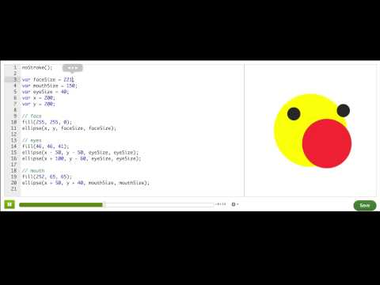
Resizing shapes with variable expressions

Slide 6
Using variable expressions
In this program, the value of b is dependent upon the value of a and the value of c is dependent upon the value of b. The println() statement prints the result of the expression that is passed to it:
var a = 25;
var b = a / 5;
var c = b + 30;
println(b + c);
What will the above program print?
Notes:
🍐 This is a Pear Deck Text Slide
🍐 To edit the type of question, go back to the "Ask Students a Question" in the Pear Deck sidebar.
40

Slide 7
Using variable expressions
Let's say we have a program that draws an ice cream cone (a triangle) with two scoops of ice cream (two ellipses) on top of it. The second scoop is slightly smaller than the first, and we have two variables, scoop1 and scoop2, to keep track of the scoop sizes:
var scoop1 = 40;
var scoop2 = 30;
triangle(200, 250, 180, 200, 220, 200);
ellipse(200, 180, scoop1, scoop1);
ellipse(200, 145, scoop2, scoop2);
If we want to make scoop2 dependent on scoop1, so that scoop2 is always 101010 pixels smaller than scoop1, what expression should we store in the scoop2 variable?
Notes:
🍐 This is a Pear Deck Text Slide
🍐 To edit the type of question, go back to the "Ask Students a Question" in the Pear Deck sidebar.
Scoop1 -10

Slide 8
Using variable expressions
Let's say we have a program that draws a simple face and body with ellipses. It uses two variables, one for body size and one for face size:
var bodySize = 100;
var faceSize = 50;
ellipse(200, 200, bodySize, bodySize);
ellipse(200, 150, faceSize, faceSize);
If we want to make faceSize dependent on bodySize, so that faceSize is always one-half bodySize, what expression should the faceSize variable store instead?
Notes:
🍐 This is a Pear Deck Text Slide
🍐 To edit the type of question, go back to the "Ask Students a Question" in the Pear Deck sidebar.
bodySize /2

Slide 9
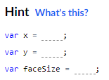
Practice: Brown bear eyes
What an innocent looking bear! In this challenge, you'll use him to get a little practice resizing with fractions and variables.
Try changing the values for x and y. Notice that the ears and nose move with the face, but the eyes don't.
Try changing the value for faceSize. Notice that the size of the ears and nose change with the size of the face, but the eyes don't.
Play around with the bear's face

Slide 10
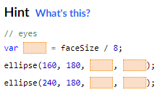
Practice: Brown bear eyes
In this step, you'll improve the code so that the size of the eyes changes when the size of the face changes.
If you look at the ellipse statements for the eyes, you can see that the width and height (third and fourth parameters) start off at 20. Originally, before you played around with it, the faceSize started off 160. So, to retain the original proportions, the eyes should always be 20/160 or 1/8 the size of the face.
To make it so that the eyes are always 1/8 of the size of the face, do the following:
- Create a new variable to store the size of the eyes and set it equal to faceSize/8
- Replace the values of 20 in the ellipse statements for the eyes with the name of the new variable
Make the eye size change with the face size

Slide 11
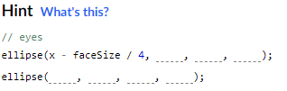
Practice: Brown bear eyes
Currently, when you change the x variable, the face moves left and right, but the left eye just stays in the same place. In this step, you'll fix the code so that when the face moves left, the left eye also moves left, and when the face moves right, the left eye also moves right. (We'll fix the right eye in the next step)
If you look at the ellipse statements for the left eye, you can see that the x coordinate (first parameter) is 160. Originally, before you played around with it, the x of the face started off at 200 and faceSize started off at 160. So, to keep the original offset between the left eye and the center of the face, the x coordinate of the left eye should be (200-160)/160 or 1/4 of the size of the face to the left of x.
To make it so that the left eye always stays 1/4 of the size of the face to the left of x, do the following:
- In the ellipse statement for the left eye, replace the value of 160 with x-faceSize/4
Make the left eye follow the face left and right

Slide 12
Practice: Brown bear eyes
Currently, when you change the x variable, the face moves left and right, but the right eye just stays in the same place. In this step, you'll fix the code so that when the face moves left, the right eye also moves left, and when the face moves right, the right eye also moves right.
If you look at the ellipse statements for the right eye, you can see that the x coordinate (first parameter) is 240. Originally, before you played around with it, the x of the face started off at 200 and faceSize started off at 160. So, to keep the original offset between the right eye and the center of the face, the x coordinate of the right eye should be (240-200)/160 or 1/4 of the size of the face to the right of x.
To make it so that the right eye always stays 1/4 of the size of the face to the right of x, do the following:
- In the ellipse statement for the right eye, replace the value of 240 with x+faceSize/4
Make the right eye follow the face left and right

Slide 13
Practice: Brown bear eyes
Currently, when you change the y variable, the face moves up and down, but the eyes just stay in the same place. In this step, you'll fix the code so that when the face moves up, the eyes also move up, and when the face moves down, the eyes also move down.
If you look at the ellipse statements for the eyes, you can see that the y coordinate (second parameter) is 180 for both of them. Originally, before you played around with it, the y of the face started off at 200 and faceSize started off at 160. So, to keep the original vertical offset between the eyes and the center of the face, the y coordinate of the eyes should be (200-180)/160 or 1/8 of the size of the face above y.
To make it so that the eyes are always 1/8 of the size of the face above y, do the following:
- In the ellipse statements for both of the eyes, replace the value of 180 with y-faceSize/8
Make the eyes follow the face up and down

Slide 14
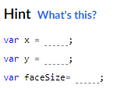
Practice: Brown bear eyes
Now that we've done all that hard work, play around with the values for x and y and faceSize. Notice how the eyes move and change size with the face now.
To prove that your changes worked, move the bear to the bottom left corner and make the bear really big (make x < 150, y > 250 and faceSize > 350 ) !
Play Time !

Slide 15
Challenge: Animal attack
Make an animal using the drawing commands, and use variables for the numbers you pass into those commands, like we do in the starter code below. You should also use variables for any repetitive information about your animal, like the eye size, so that you can change the size of both of your eyes at once.
Once you've done that, pick a variable to animate - maybe the animal's face gets huge, or one of their eyes bug out - that's the attack! Watch out, your programs are out to get you now. :)
You made lots of animals in the variables coding challenges- a bunny, a bear, a frog. What other animals can you make with shapes and variables?

